Slide 1


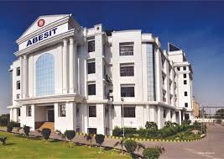
Project report on shiv(a robot for med field)
Department of Electronics & Communication Engg.
Project I.D.- 2017PJ-ECE06
Supervisor / Team Mentor -:
Dr. Hari Mohan Gaur
(H.O.D. ECE Department)
Team Members -:
1.) Pratyush Priyansh (1729031038, ECE,4TH year )
2.) Vikas Tiwari
(1729031057, ECE,4TH year )
3.) Chandresh Negi (1729031017,ECE,4TH year )

Slide 2
CONTENTS-
Introduction/Problem statement
Inspiration
Flowchart
Overview/working of idea
Workflow diagrams
Unique Features
Timeline

Slide 3
Problem Statement- Shiv- treating the affected with minimum contact possible.
Description
Shiv is an initiative to fight not just against the current surge of COVID- 19, but also other diseases that are communicable from human to human. We are trying to keep the contact between patients & doctors as minimum as possible so that we can maintain safety for doctors ,nurses & compounders as well.
Shiv can perform following tasks in order to achieve the goals-
Food & Medicine delivery -: Shiv will be able to take foods & medicines on tray like structure attached to it’s arms so that it can delivery the requisite to the patients without any involvement of nurses or compounders.
Monitoring of patients -: Shiv will be able to make “out of touch” monitoring of patients. This will help doctors as they won’t have to go to every patient bed to bed hence reducing the chances of getting in contact with asymptotic carrier.
Sanitization of the rooms -: Shiv will be able to sanitize the rooms routinely.
Family Hysteria -: In hospitals connection between patients & their families are cut, for it is feared that it increase the chances of spread of the disease, so Shiv will be able make video calls for every individual’s family so that they can chat whenever they want.
Maintaining records -: Shiv will be able to maintain to record & list different actions taken during the treatment of a patient, like maintaining records for medicines dosed or body temperatures.

Slide 4
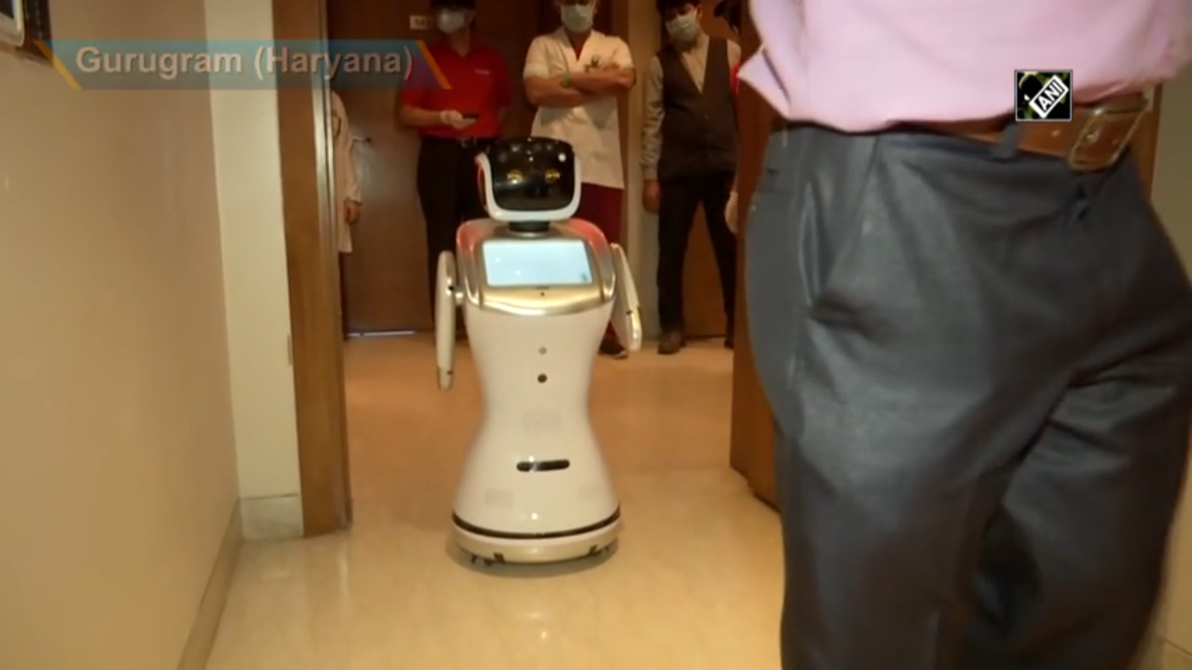
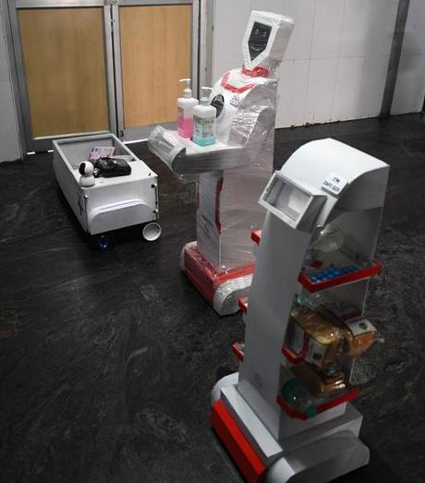
Inspiration-
Robots are nowadays a rapidly growing part in every field. humans use robots in areas where it is extremely difficult for us to reach.
In 2018, a robot named ROBOVOLC, helped scientists to discover a volcano. [refer source 2]
We are already using robots in medical fields like manufacturing of medicines or during some critical surgeries. [refer source 3]
A few states like Haryana & Tamil Nadu have implemented robots to their disposal, & while it is a very strong initiative, yet constrained to just limited number of hospitals.
Source – Reference 1 – Robots to fight against COVID-19 in Haryana (left) & Tamil Nadu (Right)

Slide 5
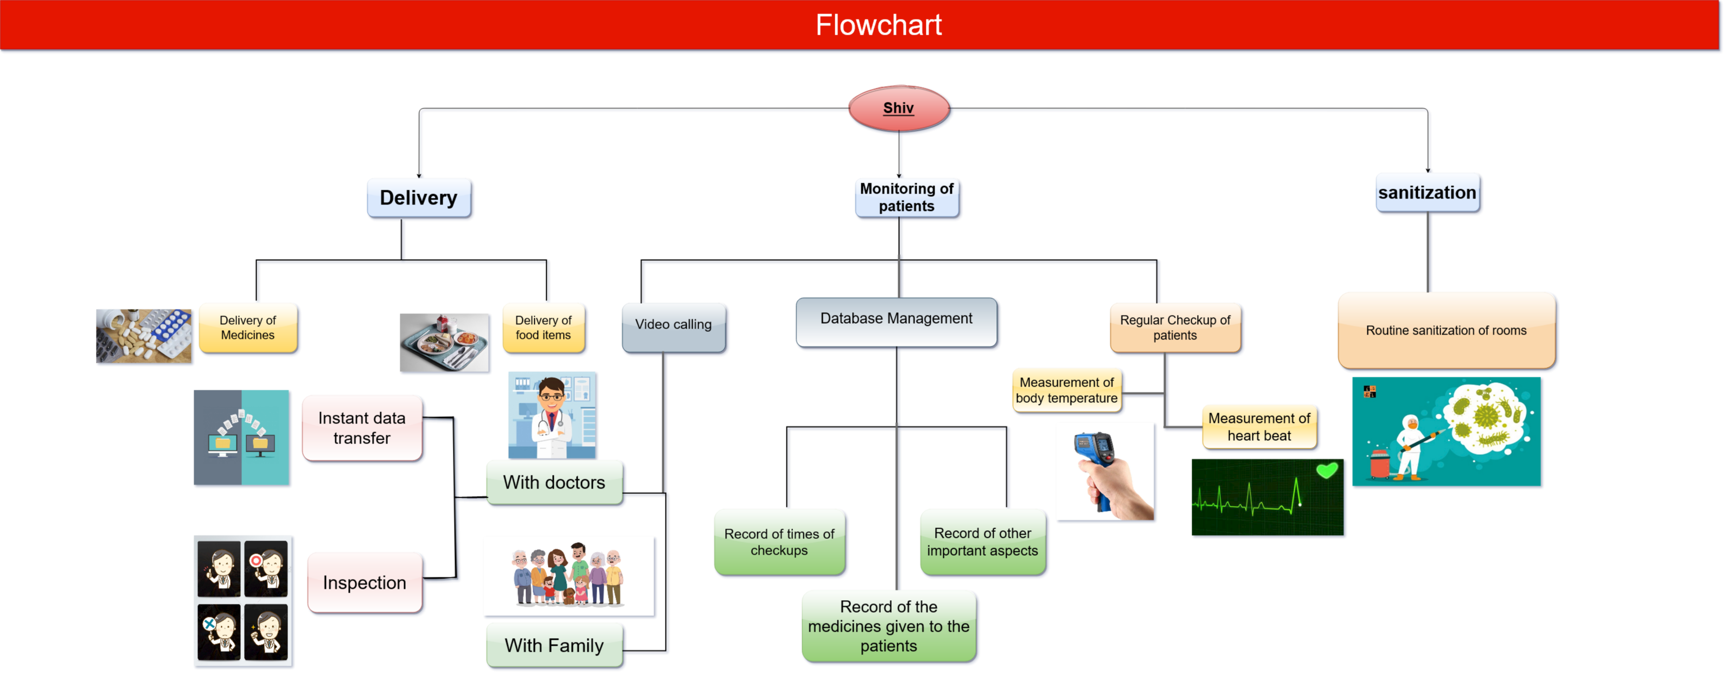

Slide 6
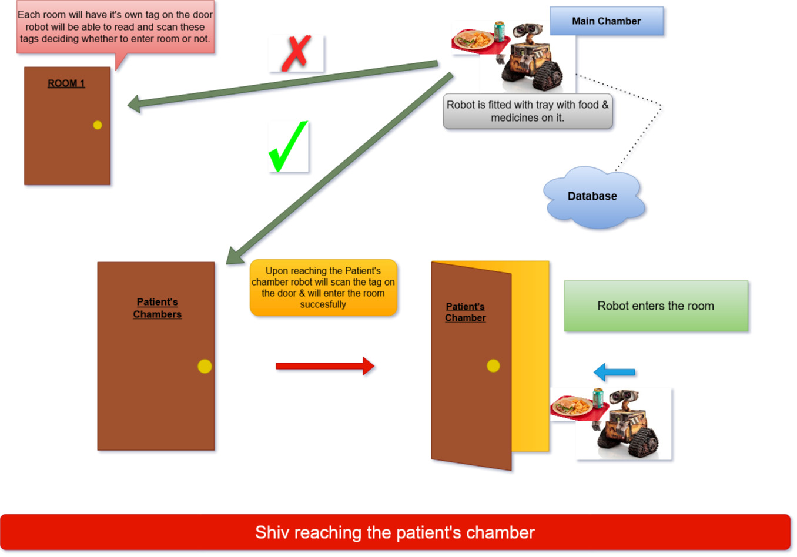
Workflow (part 1)-

Slide 7
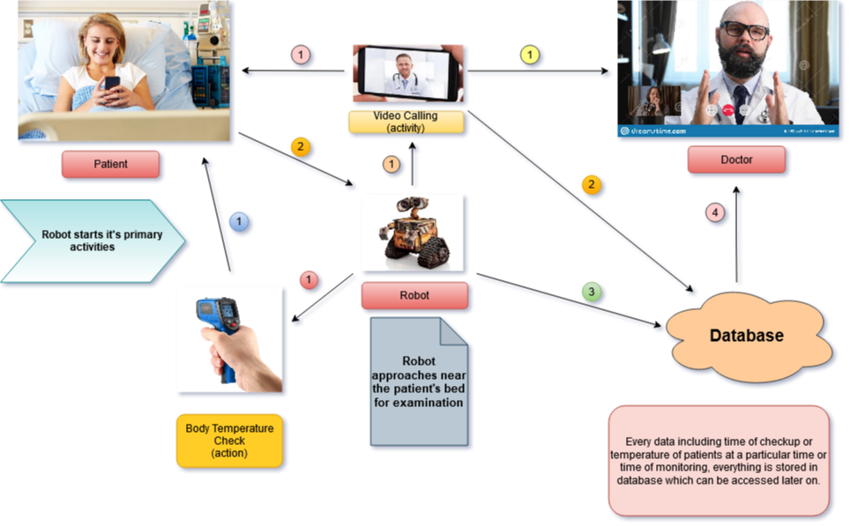
Workflow (Part 2)-

Slide 8
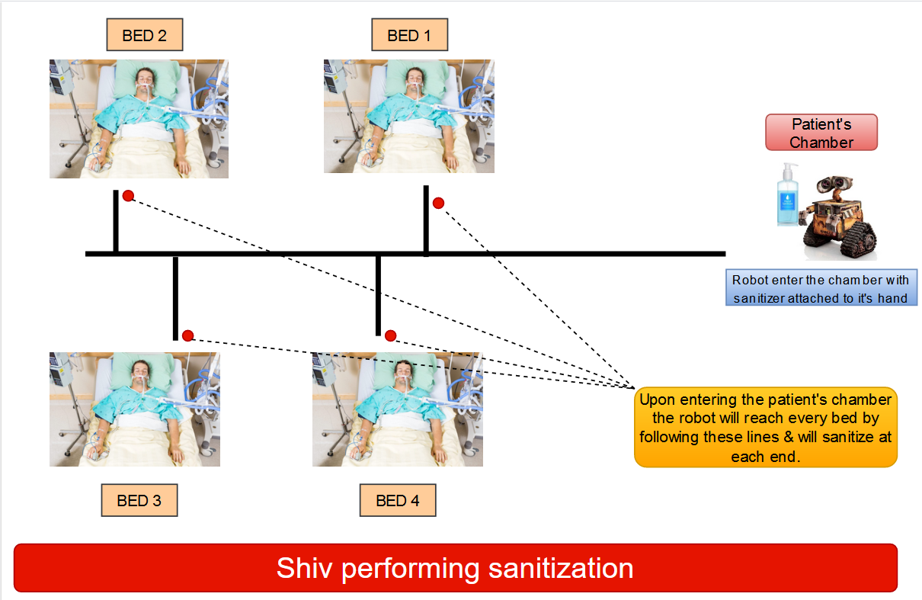
Workflow (part 3) -

Slide 9
Unique features-
Remote monitoring of patients without any contact. Hence, reducing the chances of doctors, nurses or compounders getting affected.
Equipped with various sensors & medical equipment as to perform all the necessary tests for the patient’s treatment.
Facility to get connect with family whenever patient desires.
Instantaneous recording of data of every individual patient, as to maintain the records, as well as to study the treatment methods.
Routine sanitization of patient’s chamber to make it less prone to disease.
Ability to deliver food items & medicines to every so that nurses & compounders won’t have to individually visit bed to bed of every single patients.
It will be modular, i.e., it can be fitted with tray or sanitization bottles as per the requirement.

Slide 10
SOCIAL IMPACT | ECONOMICAL IMPACT
1.) Even though it’s 21st century, not every individual is aware of the technology such as robots. | 1.) We rely too much on importing ,for technical products or even for daily used commercial products, on other countries. This has lead us to low productivity, poor development, & bad economy of the country.
2.) Treatment will attract more number of patients as they will be excited to get treatment from robot. | 2.) These robots will be based on not so high end software so they can be easily manufactured by local companies hence making them less expensive.
3.) To make every hospital & clinic a little modernise in term of technology. | 3.) Robots will be modular so that they can be easy compatible with nearly every new technology.
4.) To have knowledge of various fields & latest trends of our branch. | 4.) Treatment will be cheaper.
5.) To provide safety to doctors, nurses & compounders as much as possible. | 5.) More feasible than human staffs.

Slide 11






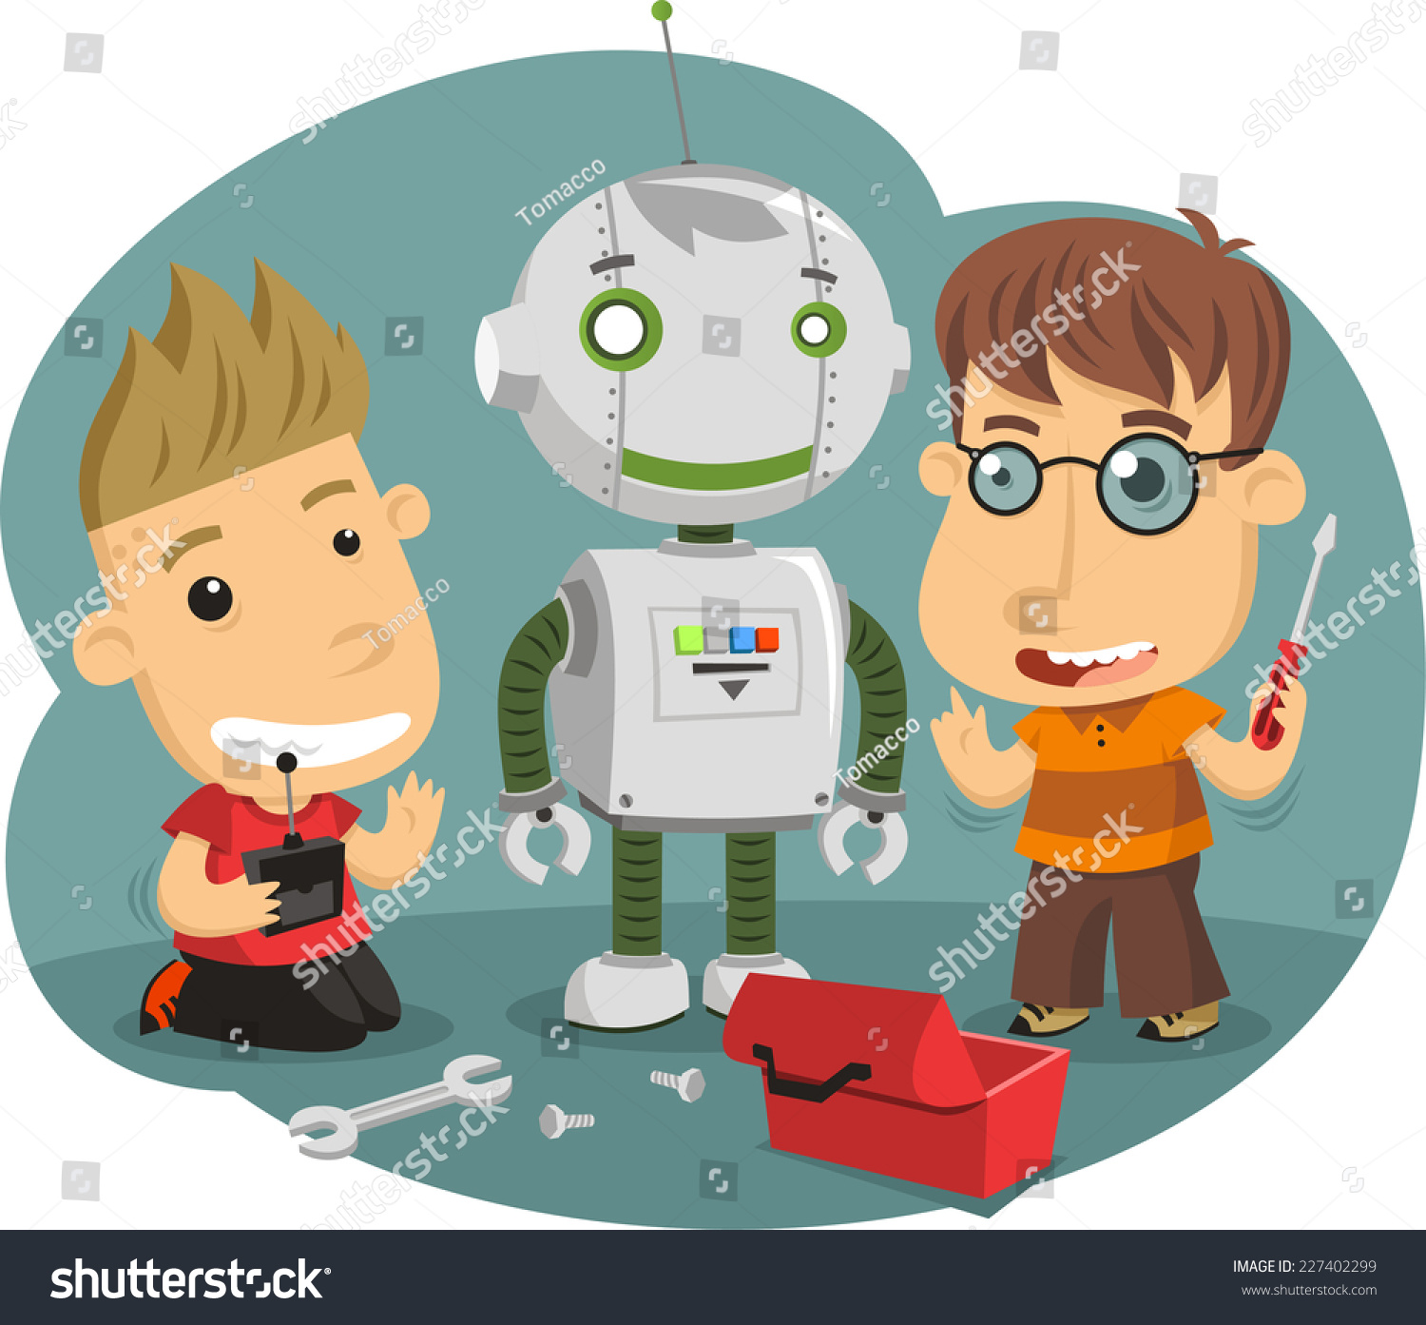

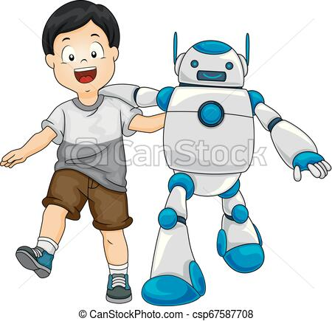
7th Semester Timeline-
Literature survey of the project
Robot capable of performing delivery by finding it’s own path
2nd Presentation
Deciding the project idea
September
October
Beginning
November
3rd presentation
Initiating assembly of the bot
Synopsis Presentation
Final Presentation
Deciding the technologies & algorithms to be implemented in the idea
A working model capable of walking

Slide 12
References-
https://www.thehindu.com/news/national/tamil-nadu/tn-covid-19-isolation-wards-to-get-robots/article31444627.ece [source1]
https://www.emerald.com/insight/content/doi/10.1108/01439910310473942/full/html [source 2]
https://online-engineering.case.edu/blog/medical-robots-making-a-difference [source 3]
https://www.manifestias.com/2020/02/28/robotics-in-india/
https://www.manifestias.com/2020/02/28/robotics-in-india/
https://indianexpress.com/article/technology/tech-news-technology/hyderabad-based-startup-launches-smart-robocop-named-after-26-11-martyr-hemant-karkare-5004011/

Slide 13


